Slide 1
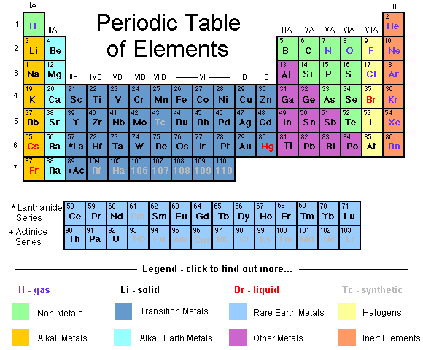

Slide 2
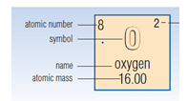
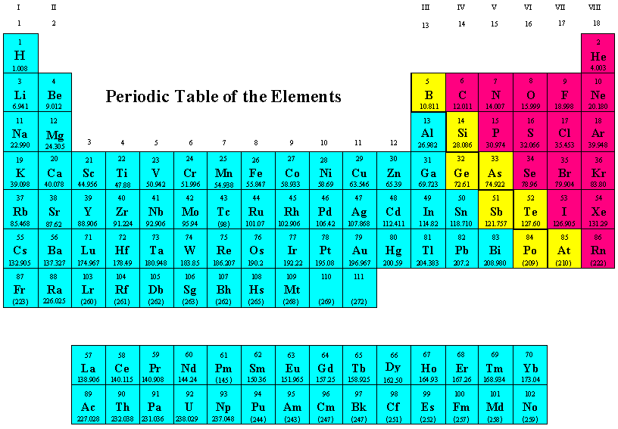
Metals & Non-Metals
Non- Metals
Metals
Metalloids

Slide 3
Groups – Organized In Columns
Groups

Slide 4
Periods – Organized In Rows
Periods

Slide 6
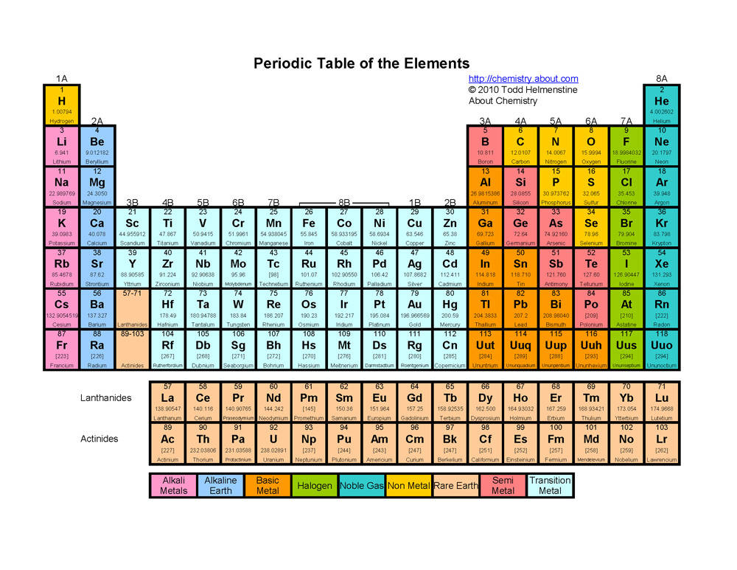
Periodic Table Groups & Colours

